Slide 1
MIS 710 Process and Innovation Management
2 – Process / Workflow Design
Part I
Process Perspectives
Event/Process Charts
Class Exercise on EPC Charts
Part II
Petrinet Modeling
BPMN Process Mapping
An introduction to workflow is in Stohr, E.A. and J.L. Zhao, “Workflow Automation: Overview and Research Issues”. Information Systems Frontiers, August 2001. 22
Notes:
Up to this point, we have been concerned with choosing & designing business processes.
In this lecture, we look at:
Simulation: How to check alternative process designs
WFMS: How to automate processes
Since not all processes can be expressed as fixed workflows, we also look at:
Groupware: How to support coordination in unstructured situations
Finally, we look at 2 real case studies involving the implementation of a WFMS

Slide 2
Business Processes – General
Business Processes
cross organizational boundaries
mean different things to different audiences
Every work process:
has an objective
has specific starting and finishing conditions
can be described at different level of abstraction
Process models help organizations evaluate
what they do currently
what they should do, and
how they can get from a) to b)

Slide 3
Five Workflow “Perspectives”
The functional perspective. What does the workflow do? This perspective specifies the workflow by decomposing high level functions into tasks that can be allocated to humans or software
The behavioral perspective. When are the activities and tasks executed? A process model defines the time precedence of individual process activities, the events and triggers, and the pre- and post-conditions for activities. Rules associate agents with roles, roles with activities, and activities with data and software applications. These can be specified using process logic in EPC, Petri nets, BPMN or other process models
The informational perspective. What data is consumed and produced? This perspective describes the business data, documents, and electronic forms that are transported between agents, and the files and databases that store persistent application information.

Slide 4
Five Workflow “Perspectives” ctd
The operational perspective. How is a workflow activity implemented? The WfMS provides coordination as specified by the behavioral perspective. The operational perspective specifies the workflow tools and applications that perform the discrete steps of the process.
The organizational perspective describes the interaction of human actors in the process: the roles to be performed, the organization structure that manages the people performing the roles, the access rights to software and data, etc.

Slide 5
EPC Symbols
Event: A perceived change of status at one point in time which is of interest to the server organization. Signifies that something has occurred (e.g., Customer Order Received) (past tense).
Function/activity: An activity or series of activities performed over time by the customer or by the serving organization in conjunction with the customer. Often in response to a triggering event. E.g., “Enter Order”
Branch/Connector/Gate: Conditional splitting of an event-process flow into multiple sub-flows based on the value(s) of certain status variable(s). Branch types AND, XOR & OR.
Swimlane(s) organize events and functions performed by different parties into separate visual categories.
Only in Kim Methodology:
Wait: A significant delay before the start of an event or process (as experienced by the customer).
Organization
W
Notes:
Note that the W is new here - it is a form of abstraction - we use it to hide the service process that is being performed ...

Slide 6
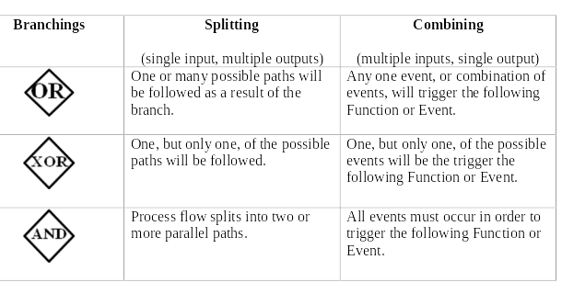
EPC Branch Connectors
Branch/Connector/Gate: Conditional splitting of an event-process flow into multiple sub-flows based on the value(s) of certain status variable(s). Branch types AND, XOR & OR.

Slide 7
Rules for Modeling in EPC
Functions/activities and Events always alternate.
Functions/activities and Events only have a single incoming and outgoing connection.
Process paths always split and combine using Connectors.
Connectors cannot have multiple inputs and multiple outputs.

Slide 8
EPC Example
[From Young-Gul Kim: Case Packet]
Internal Medicine
[60 min]
E2
Have
registered
W1
E3
Consultation
Complete
Need
Medicine?
No
P2: Consult
Doctor
[15 min]
Yes
Administrative Center
E4: Medicine
Needed
E7
Visit
Completed
E1
Customer
Arrival
P1:
Registration
[15 min]
P3: Pay for
Prescription
[30 min]
Pharmacy
E5
Request
Medicine
E6
Receive
Medicine
Process cycle time = 2.5 hours
W2
[30 min]
Notes:
Note that the event “Customer receives slip” is subsumed in the P1: Process - this is a matter of taste

Slide 9
EPC Example
[From Young-Gul Kim: Case Packet]
Reception Desk
E4
Medicine
packed
E1
Prescription
Received
W1
Medicine Shelf
[5 min]
P1:
Retrieve
Medicine
E2
Medicine
Received
P2:
Proportion
Medicine
[10 min]
[5 min]
Packaging Booth
E3
Deliver
Medicine
P3:
Pack
Medicine
Detail of Customer Wait W2
[10 min]
Process cycle time = 30 mins
Notes:
This is a sequential process:
- can it be made parallel?
- should it be performed by case workers?
- are different people involved?

Slide 10
EPC Example
[From Young-Gul Kim: Case Packet]
Additional Doctors
Electronic Billing
Internal Medicine
W1
[30 min]
P2:
Consult Doctor
Need
Medicine?
No
[15 min]
Yes
Lobby
Electronic Transmission of Prescription
E1
Customer
Arrival
E2
Registration
E4
Visit
Completed
Smart Card Machine
Pharmacy
Electronic Billing
E3
Receive
Medicine
Reengineered Process
Process cycle time = 45 mins
Notes:
Note the addition of technology has eliminated one process (P3) and turned another into an event (P1)
Note that the only way to reduce the wait before consultation was to add more doctors

Slide 11
In-class Exercise
Bank Loan Processing EPC

Slide 12
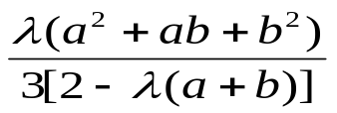
Bank Loan Example
Exponential inter arrival distribution and Uniformly distributed service times
The formula for the queuing time (time spent in queue alone, not including service time) in a queue with exponential arrivals and service time uniformly distributed is:
W =
where, the average arrival rate for the exponential distribution is λ, and the
processing time is uniformly distributed between [a,b].
Uniform Service times
Exponential Interarrival times
Mean = 30 mins
a =15 mins -- b= 20 mins
W = ?
Loan Processing Center
Using formula W = 12.3 mins
S = 17.5 mins
Credit Check
S = ?

Slide 13
Petri Net Illustration
Process “Handle Complaint”
Contact-Client
Assess
Pay
c1
c3
c6
Positive
AND Split
AND Join
c5
File
Record
Collect
XOR Split
XOR Join
c8
Start
End
c2
c4
Negative
Contact-Dept
c7
Send-Letter
Token
Tokens are moved through the net by the firing of transitions. In a Workflow one or more tokens represent a case. Each case has a unique identifier that is carried by each token representing the case.
Place/Condition
A Place is passive. In a Workflow it represents a condition (or event).
Transition
A transition fires immediately when there is a token in each of its input places.
It places a token in each of its output places.

Slide 14
PetriNet Illustration
Contact-Client
Assess
Pay
c1
c3
c6
Positive
AND Split
AND Join
c5
File
Record
Collect
XOR Split
XOR Join
c8
Start
End
Negative
c2
Contact-Dept
c4
c7
Send-Letter
Step 1: The claim has been recorded

Slide 15
PetriNet Illustration
Contact-Client
Assess
Pay
c1
c3
c6
Positive
AND Split
AND Join
c5
File
Record
Collect
XOR Split
XOR Join
c8
Start
End
Negative
c2
Contact-Dept
c4
c7
Send-Letter
Step 1: The claim has been recorded
Step 2: The client has been contacted
(Note – either Contact-Client or Contact-Dept can be executed first or both can proceed in parallel)

Slide 16
Petrinet Illustration
Each Case has one or more tokens:
Case 4
Case1
c1
Contact-Client
c3
Case 3
Assess Positive
c6
Pay
Case 5
c5
File
Record
Collect
c8
Start
End
Case 2
c2
c4
Assess Negative
c7
Contact-Dept
Send-Letter
Subprocesses can be represented:
c2
Contact-Dept
c4
Subprocess for “Contact Department”

Slide 17
Notation
AND Split
AND Join
Produce tokens for ALL output arcs
Synchronize: fire when tokens available on ALL input arcs
OR Split
OR Join
Produce tokens for ONE output arc
Fire when a token is available on ONE of the input arcs
Looping Constructs:
t
t
Repeat Until (execute t at least once)
Do While (may or may not need to execute t repeatedly)

Slide 18
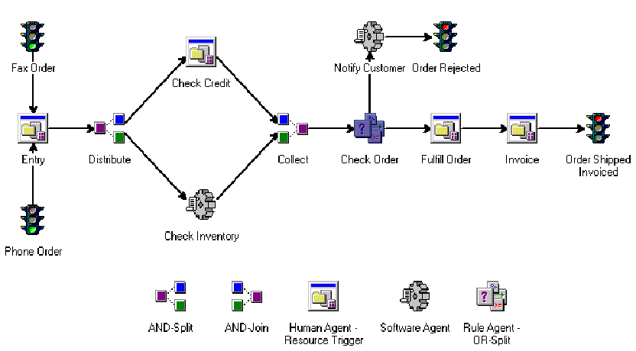
Notation in Optika’s Acorde

Slide 19
Triggers
Workflows are subject to external events. Often cases must wait until some resource is ready to work on it, till a certain amount of time has elapsed, or till a message is received.
R - Resource trigger. Often represents a human being. Operators may not be available or are not always ready to work.
T - Time trigger. Indicates that the transition can only fire at a certain point in time - say one week before due date or after a certain period of time has elapsed or at some fixed time interval - e.g. 3:00 pm on Fridays.
E - External event trigger. The event might represent the receipt of a letter, or EDI message.

Slide 20
Travel Agency Example
Contact- cust
R
R
R
R
End
Start
Register
Search
Commu-nicate
XOR Split
R
E
XOR Join
Cancel
Book
R
R
T
T
AND Split
Ins 1?
Insur 1
AND Join
Send-documents
Start-trip
R
Ins 2?
Insur 2

Slide 21
Resource Allocation
Complaints Process
Role
Org. Unit
Employee
Assessor
Complaints
Finance
c1
Contact-Client
c3
Assess Positive
c6
Pay
R
c5
R
File
R
Record
Collect
c8
Start
R
End
R
R
Assess Negative
c2
Contact-Dept
c4
c7
Send-Letter
Example adapted from Aalst & van Hee (2003)

Slide 22
Allocation of Resources
Resource
Class/Role
Resources
Task
Role
Organiz.
Unit
Employee
John
Jim
Jack
Liz
Mandy
Carl
Record
Contact_Client
Contact_Dept
Collect
Assess
Pay
Send-Letter
File
Employee
Employee
Employee
---
Assessor
Employee
Employee
---
Complaints
Complaints
Complaints
---
Complaints
Finances
Complaints
---
Assessor
Mandy
Carl
Complaints
John
Jim
Mandy
Carl
An allocation rule assigns a resource (say Mandy) in a resource class (say Complaints) that can perform a role (say Assessor) to an activity instance (say Assess) associated with a particular case. This allocation may be based on case attributes or other rules that guide the decision on the particular resource to be chosen (either Mandy or Carl in this example).
Finances
Liz
Jack

Slide 23
Run-Time Assignments
Case 4
Case 5
Case1
c1
Contact-Client
c3
Case 3
Assess Positive
c6
Pay
R
c5
R
File
Start
R
Record
Collect
c8
End
Case 6
R
Case 2
R
c2
c4
Assess Negative
c7
Contact-Dept
Send-Letter
Work Items
Active Activities
Case
Task
Case
Task
Allocated
Resource
Case 1
Case 3
Case 5
Case 5
Pay
Assess
Contact_Client
Contact_Dept
Case 2
Case 4
Case 6
Assess
Contact_Dept
Record
Mandy
Jim
---
A Work Item is a piece of work waiting to be selected for execution by a resource; it is on a “work list”

Slide 24
Process Modeling Problems
Increasing number and diversity of
- information model applications
- modeling methods
- model designers
- model users
Increasing number and scope of models
➔ Increasing complexity of process modeling and process models
The following slides are adapted from Michael zur Muehlen’s course notes
Notes:
Ansätze zur Reduktion und Beherrschung der Komplexität
sind zu entwickeln
Ziel: Qualität von Informationsmodellen erhöhen
Mittel:
- Ordnungsrahmen als Systematisierungsbasis herleiten
- bestehende Gestaltungsempfehlungen einordnen
- neue Gestaltungsempfehlungen erarbeiten
- ggf. methodische erweiterungen erarbeiten

Slide 25
Multiple Methodologies
Problems of process modeling:
  De-facto-standards emerging slowly
  Numerous methods correlate with numerous tools
  Organizational focus and IT-focus
Problems of procedure models
  Procedure model varies with selected methodology
  Starting point and goal of process modeling is not precisely defined
  Multiple recipients demand different levels of abstraction (management / shop-floor)

Slide 26
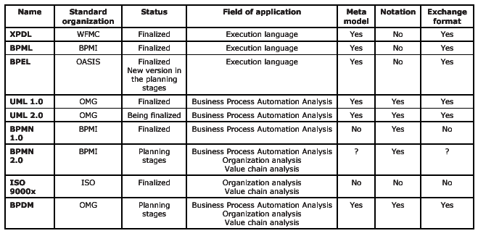
Standards for Process Modeling

Slide 27
Relevant Types of Process Models
Process Model
Business Process Model
Workflow Model
Business Improvement
example: EPC
Process Automation
example: BPMN

Slide 28

BPMI.org Hourglass
Audiences:
Business Environment
Purposes:
Strategy Consultants
Business Analysts
BPMN
Modeling
Process Designers
Focus 
BP
Scope 
BPEL
System Architects
Execution
Software Engineers
Technology Implementation

Slide 29
Process Model Definition
A Process Model is the representation of a process for the purposes defined by a model user (esp. a designer of information systems and organizational structures)
Methods:
  Petri-Nets
  Event-driven Process Chains
  Business Process Modeling Notation
  Data flow diagrams – model individual tasks
  ...
There are many different ways to represent an existing process.
Problem: Do we model according to a specific tool or is there a chance to “generalize” the description of processes?

Slide 30
Basic Building Blocks of a Process
Objects / Artifacts / Cases
  Objects pass through a process and change their state according to the tasks performed on them. An object is the central building block, because different processes are distinguished by the very objects they affect.
Activities / Steps / Tasks
  Activities are units of work that are performed within a process. The same activity may be enacted in different processes and on different objects. Thus, activities should be designed in a reusable fashion.
Resources / Participants
  Resources are required to perform activities and can act either active (e. g. human resources) or passive (e. g. material)

Slide 31
BPMN Objectives
Business Process Modeling Notation (BPMN)
  BPMN provides businesses with the capability of defining and understanding their internal and external business procedures through a Business Process Diagram, which will give organizations the ability to communicate these procedures in a standard manner.
  Standardized. The notation will be understandable across all organizations and modelers
  BPMN also is supported with an internal model that will enable the generation of executable workflows using BPEL4WS.

Slide 32
BPMN Notation + Examples

Slide 33
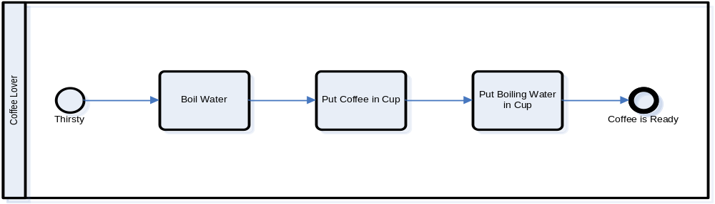
Coffee Making Process in BPMN

Slide 34
BPMN Core Elements
The core set of modeling elements enable the easy development simple Business Process Diagrams that will look familiar to most Business Analysts (a flowchart diagram)

Slide 35
BPMN Activities
An activity is work that is performed within a business process. An activity can be atomic or non-atomic (compound).
The types of activities that are a part of a Process Model are: Process, Sub-Process, and Task.

Slide 36
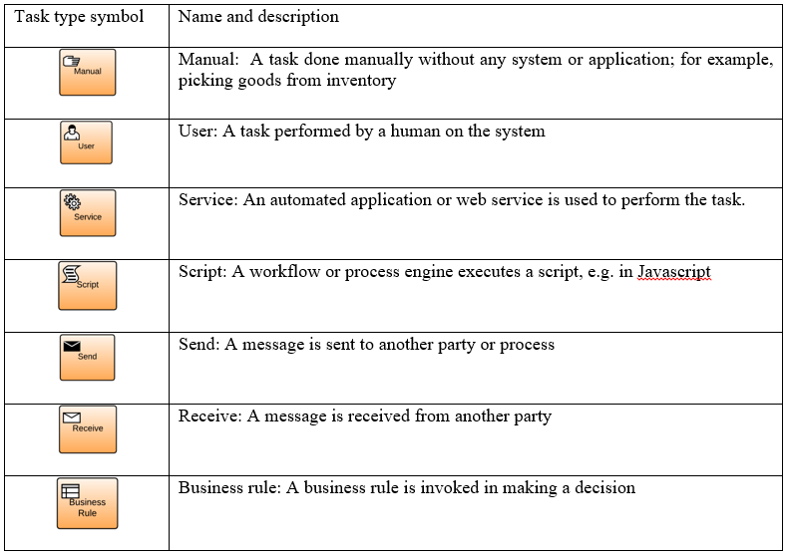
Different task types in BPMN 2.0

Slide 37
BPMN Gateways
Gateways are modeling elements that are used to control how Sequence Flows interact as they converge and diverge within a Process. If the flow does not need to be controlled, then a Gateway is not needed.

Slide 38
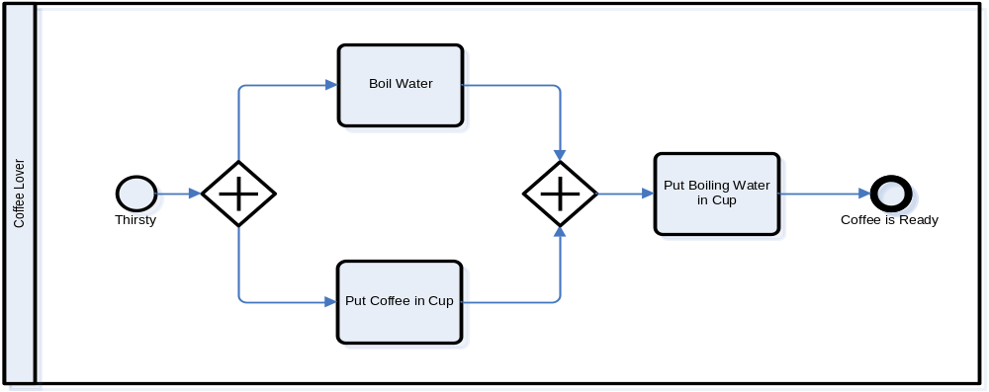
Splits and Joins in BPMN

Slide 39
BPMN Events
An Event is something that “happens” during the course of a business process. These Events affect the flow of the Process and usually have a trigger or a result. They can start, interrupt, or end the flow.

Slide 40
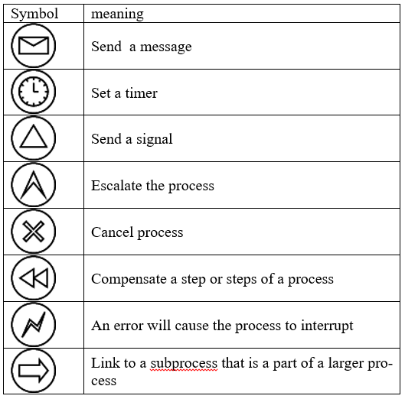
Additional symbols used in BPMN modeling

Slide 41
BPMN Swimlanes and Pools
A Pool is a “swimlane” and a graphical container for partitioning a set of activities from other Pools, usually in the context of B2B situations.
A Lane is a sub-partition within a Pool and will extend the entire length of the Pool, either vertically or horizontally.

Slide 42
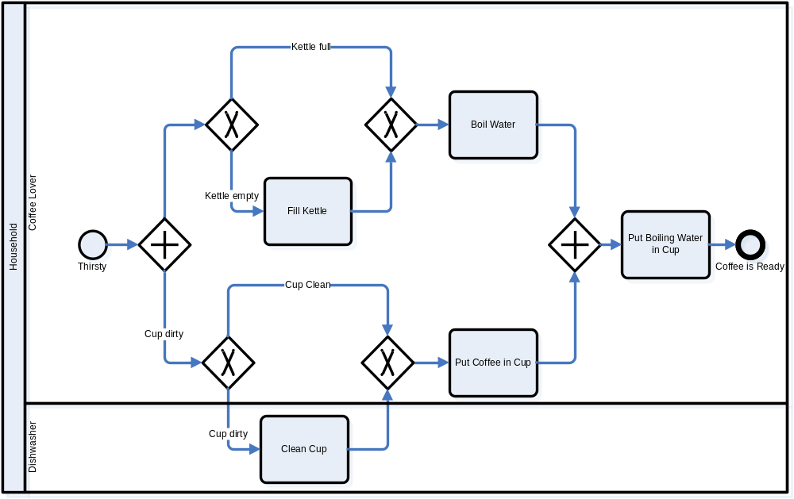
Swimlanes and Pools

Slide 43
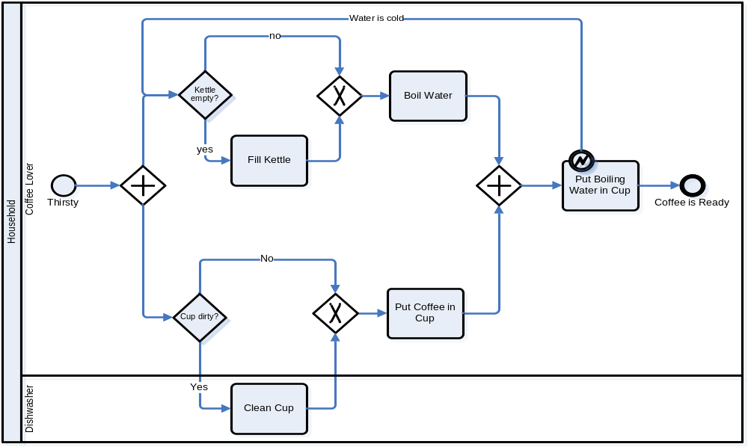
BPMN Events

Slide 44
BPMN Activities, Part 2
A Sub-Process can be in an expanded form that shows the process details of the a lower-level set of activities.

Slide 45
BPMN Connections
A Sequence Flow is used to show the order that activities will be performed in a Process.
A Message Flow is used to show the flow of messages between two entities that are prepared to send and receive them.
An Association is used to associate information and artifacts with flow objects.

Slide 46
Normal Flow

Slide 47
B2B Modeling

Slide 48
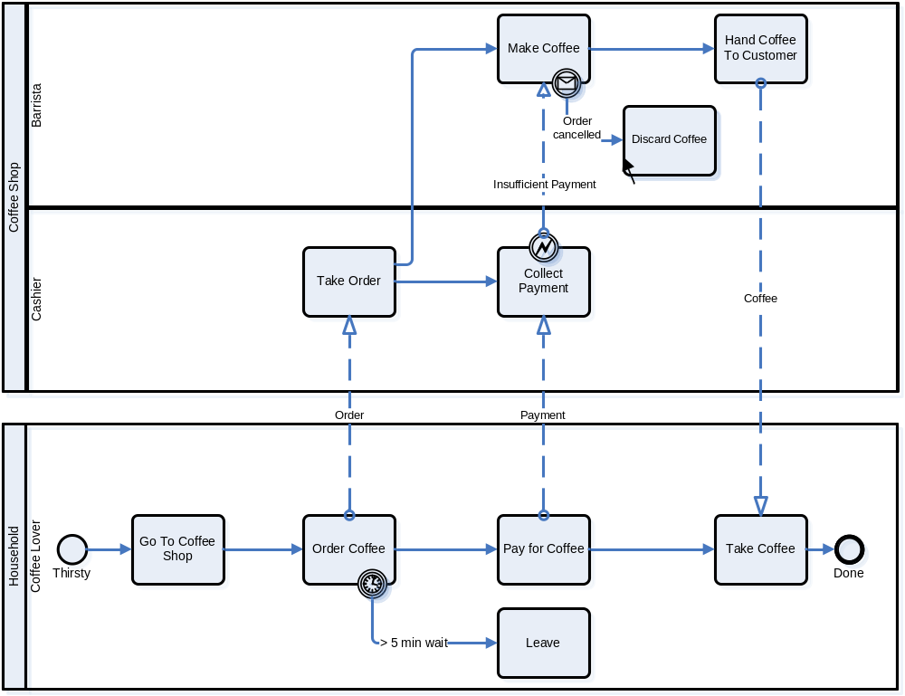
BPMN Exceptions & Compensation

Slide 49
Exception Handling
Intermediate Events attached to the boundary of an activity represent triggers that can interrupt the activity.
All work within the activity will be stopped and flow will proceed from the Event.
Timer, Exceptions, Messages, etc. can be Triggers.

Slide 50
Compensation Handling & Transactions
A Transaction is an activity that has a double border. Transactions are supported by a transaction protocol (e.g., WS-Transaction).
Normal Outgoing Sequence Flow represents the path to follow a successful completion.
A Cancel Intermediate Event represents the path to follow a cancelled completion.
An Exception Intermediate Event represents the path to follow a transaction hazard.
Activities used for compensate (with marker) are outside normal flow and are Associated normal activities.

Slide 51
BPMN Artifacts
Data Objects are not flow objects (i.e., connected through Sequence Flow), but they do provide information about how documents, data, and other objects are used and updated within a Process.
Text Annotations are a mechanism for a modeler to provide additional information for the reader of a BPMN diagram.
Groups provide a mechanism to visually organize activities

Slide 52
A More Complex Process

Slide 53
Mapping to BPEL4WS Sample
<process name="EMailVotingProcess">
<!-- The Process data is defined first-->
<sequence>
<receive partnerLink="Internal" portType="tns:processPort"
operation="receiveIssueList“ variable="processData"
createInstance="Yes"/>
<invoke name="ReviewIssueList" partnerLink="Internal"
portType="tns:internalPort" operation="sendIssueList"
inputVariable="processData“ outputVariable="processData"/>
<switch name="Anyissuesready">
<!-- name="Yes" -->
<case condition="bpws:getVariableProperty(ProcessData,NumIssues)>0">
<invoke name=“DiscussionCycle“ partnerLink="Internal"
portType="tns:processPort" operation=“callDiscussionCycle"
inputVariable="processData"/>
<!– Other Activities not shown -->
<!--name="No" -->
</case>
<otherwise>
<empty/>
</otherwise>
</switch>
</sequence>
</process>

